Slide 1
Direct3D New Rendering Features
Max McMullen
Direct3D Development Lead
Microsoft

Slide 2
New Rendering Features
Direct3D 11.3 & Direct3D 12

Slide 3
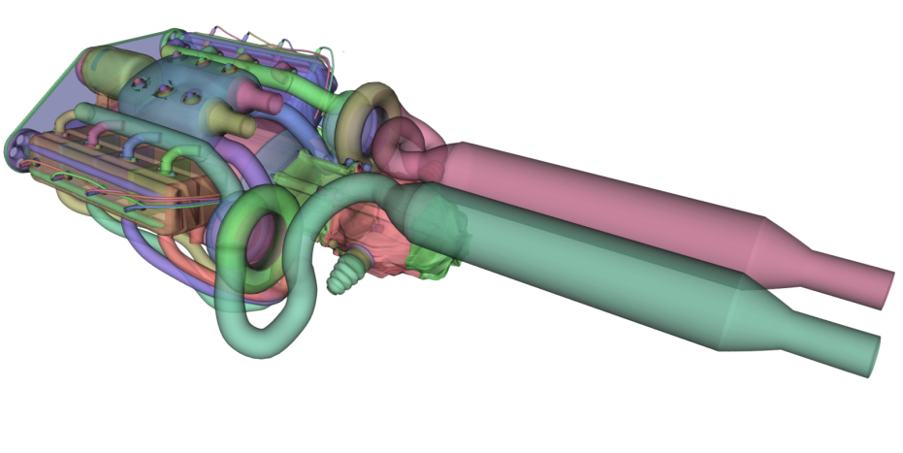
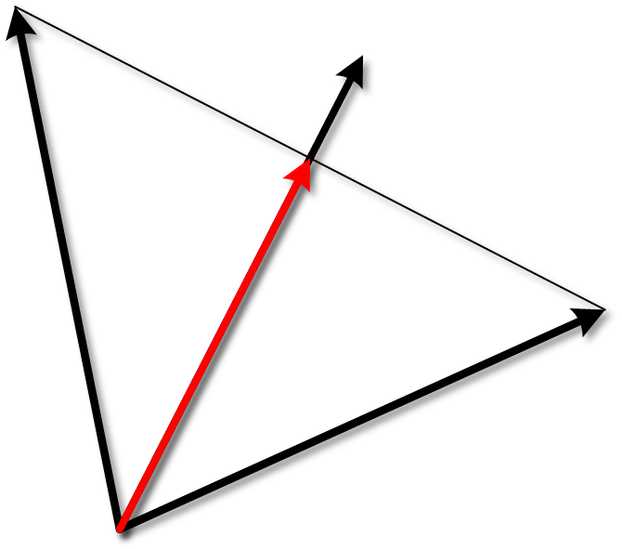
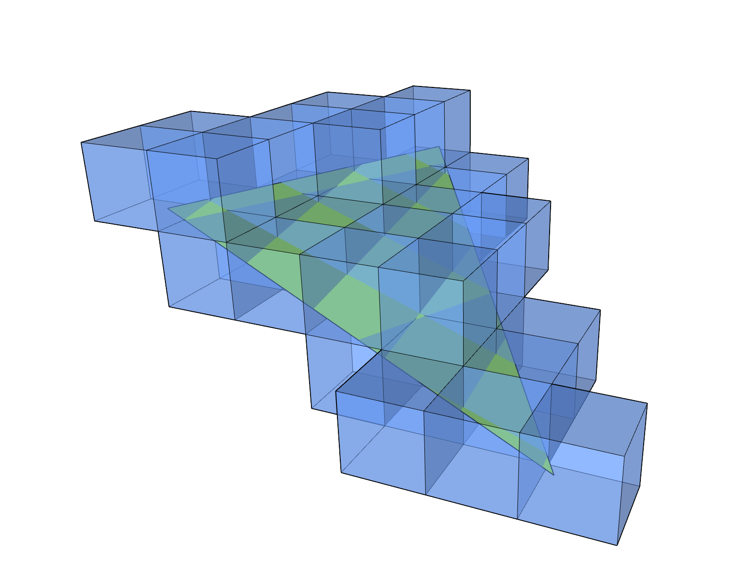
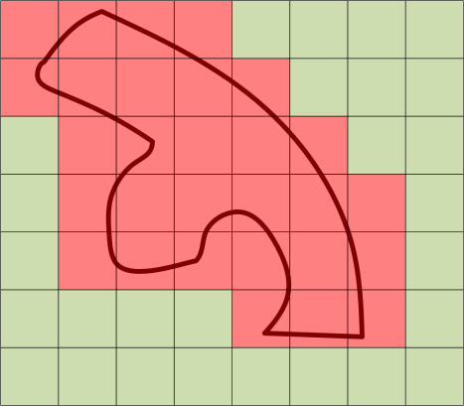
Feature Focus
Rasterizer Ordered Views
Typed UAV Load
Volume Tiled Resources
Conservative Raster

Slide 4
Rasterizer Ordered Views
UAV reads & writes with render order semantics
Enables
Custom blending
Order independent transparency
Antialiasing
…
Repeatability
Data structure manipulation

Slide 5
Order Independent Transparency
Efficient order-independent transparency
No CPU sorting… finally
Fast & Incorrect
Fast & Correct
Slow & Correct
Without ROVs
With ROVs

Slide 6
Rasterizer Ordered Views
So what’s the problem?
Viewport

Slide 7
Rasterizer Ordered Views
GPUs process MANY pixels at the same time, here are two threads:
A: (1st triangle)
B:(2nd triangle)
RWTexture1D uav;
void PSMain(float c /*=1.0f*/)
{
// ...
val = uav[0];
val = val + c;
uav[0] = val;
// ...
}
RWTexture1D uav;
void PSMain(float c /*=2.0f*/)
{
// ...
val = uav[0];
val = val + c;
uav[0] = val;
// ...
}
Viewport

Slide 8
Rasterizer Ordered Views
Two at the same time, but not exactly in sync
A:
B:
RWTexture1D uav;
void PSMain(float c /*=1.0f*/)
{
// ...
val = uav[0];
val = val + c;
uav[0] = val;
// ...
}
RWTexture1D uav;
void PSMain(float c /*=2.0f*/)
{
// ...
val = uav[0];
val = val + c;
uav[0] = val;
// ...
}
Viewport

Slide 9
Rasterizer Ordered Views
A:
B:
RWTexture1D uav;
void PSMain(float c /*=1.0f*/)
{
// ...
val = uav[0];
val = val + c;
uav[0] = val;
// ...
}
RWTexture1D uav;
void PSMain(float c /*=2.0f*/)
{
// ...
val = uav[0];
val = val + c;
uav[0] = val;
// ...
}
Viewport

Slide 10
Rasterizer Ordered Views
One of our threads writes first. How much earlier??
A:
B:
RWTexture1D uav;
void PSMain(float c /*=1.0f*/)
{
// ...
val = uav[0];
val = val + c;
uav[0] = val;
// ...
}
RWTexture1D uav;
void PSMain(float c /*=2.0f*/)
{
// ...
val = uav[0];
val = val + c;
uav[0] = val;
// ...
}
Viewport

Slide 11
Rasterizer Ordered Views
What did each thread read or write? When? It might change??
A:
B:
RWTexture1D uav;
void PSMain(float c /*=1.0f*/)
{
// ...
val = uav[0];
val = val + c;
uav[0] = val;
// ...
}
RWTexture1D uav;
void PSMain(float c /*=2.0f*/)
{
// ...
val = uav[0];
val = val + c;
uav[0] = val;
// ...
}
Viewport
uav[0] = ...
1? 2? 3?

Slide 12
Rasterizer Ordered Views
With ROVs the order is defined!
A:
B:
ROVTexture1D uav;
void PSMain(float c /*=1.0f*/)
{
// ...
val = uav[0];
val = val + c;
uav[0] = val;
// ...
}
ROVTexture1D uav;
void PSMain(float c /*=2.0f*/)
{
// ...
val = uav[0];
val = val + c;
uav[0] = val;
// ...
}
Viewport

Slide 13
Rasterizer Ordered Views
“A” goes first, always…
A:
B:
ROVTexture1D uav;
void PSMain(float c /*=1.0f*/)
{
// ...
val = uav[0];
val = val + c;
uav[0] = val;
// ...
}
ROVTexture1D uav;
void PSMain(float c /*=2.0f*/)
{
// ...
val = uav[0];
val = val + c;
uav[0] = val;
// ...
}
Viewport

Slide 14
Rasterizer Ordered Views
“B” waits…
A:
B:
ROVTexture1D uav;
void PSMain(float c /*=1.0f*/)
{
// ...
val = uav[0];
val = val + c;
uav[0] = val;
// ...
}
ROVTexture1D uav;
void PSMain(float c /*=2.0f*/)
{
// ...
val = uav[0];
val = val + c;
uav[0] = val;
// ...
}
Viewport

Slide 15
Rasterizer Ordered Views
A:
B:
ROVTexture1D uav;
void PSMain(float c /*=1.0f*/)
{
// ...
val = uav[0];
val = val + c;
uav[0] = val;
// ...
}
ROVTexture1D uav;
void PSMain(float c /*=2.0f*/)
{
// ...
val = uav[0];
val = val + c;
uav[0] = val;
// ...
}
Viewport

Slide 16
Rasterizer Ordered Views
A:
B:
ROVTexture1D uav;
void PSMain(float c /*=1.0f*/)
{
// ...
val = uav[0];
val = val + c;
uav[0] = val;
// ...
}
ROVTexture1D uav;
void PSMain(float c /*=2.0f*/)
{
// ...
val = uav[0]; // = 1.0f
val = val + c;
uav[0] = val;
// ...
}
Viewport

Slide 17
Rasterizer Ordered Views
A:
B:
ROVTexture1D uav;
void PSMain(float c /*=1.0f*/)
{
// ...
val = uav[0];
val = val + c;
uav[0] = val;
// ...
}
ROVTexture1D uav;
void PSMain(float c /*=2.0f*/)
{
// ...
val = uav[0];
val = val + c;
uav[0] = val;
// ...
}
Viewport

Slide 18
Rasterizer Ordered Views
A:
B:
ROVTexture1D uav;
void PSMain(float c /*=1.0f*/)
{
// ...
val = uav[0];
val = val + c;
uav[0] = val;
// ...
}
ROVTexture1D uav;
void PSMain(float c /*=2.0f*/)
{
// ...
val = uav[0];
val = val + c;
uav[0] = val;
// ...
}
Viewport

Slide 19
Rasterizer Ordered Views
Same value every time!
A:
B:
ROVTexture1D uav;
void PSMain(float c /*=1.0f*/)
{
// ...
val = uav[0];
val = val + c;
uav[0] = val;
// ...
}
RasterizerOrderedTexture1D uav;
void PSMain(float c /*=2.0f*/)
{
// ...
val = uav[0];
val = val + c;
uav[0] = val;
// ...
}
Viewport
uav[0] = 3.0f

Slide 20
Typed UAV Load
Used with UAV stores
Before
Only 32-bit loads
SW unpacking
SW conversion
Now
First class loading
UAV read/write operations with full type conversion
Combined with ROVs
Perform complex read-modify-write operations
Aka programmable blend

Slide 21
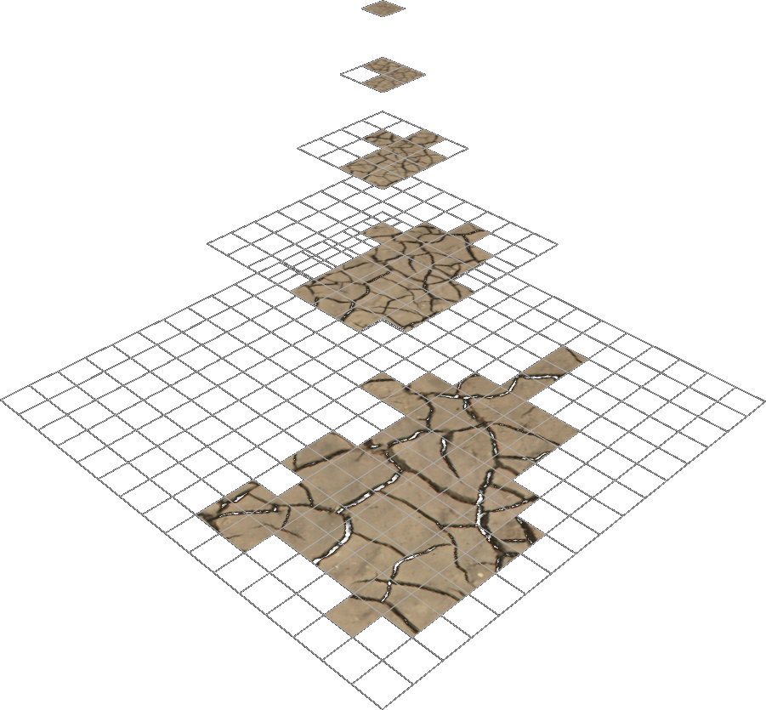
Background: Tiled Resources
Sparse allocation
You don’t need texture everywhere
Memory reuse
Use the same memory in multiple places
Aka Mega-Texture

Slide 22
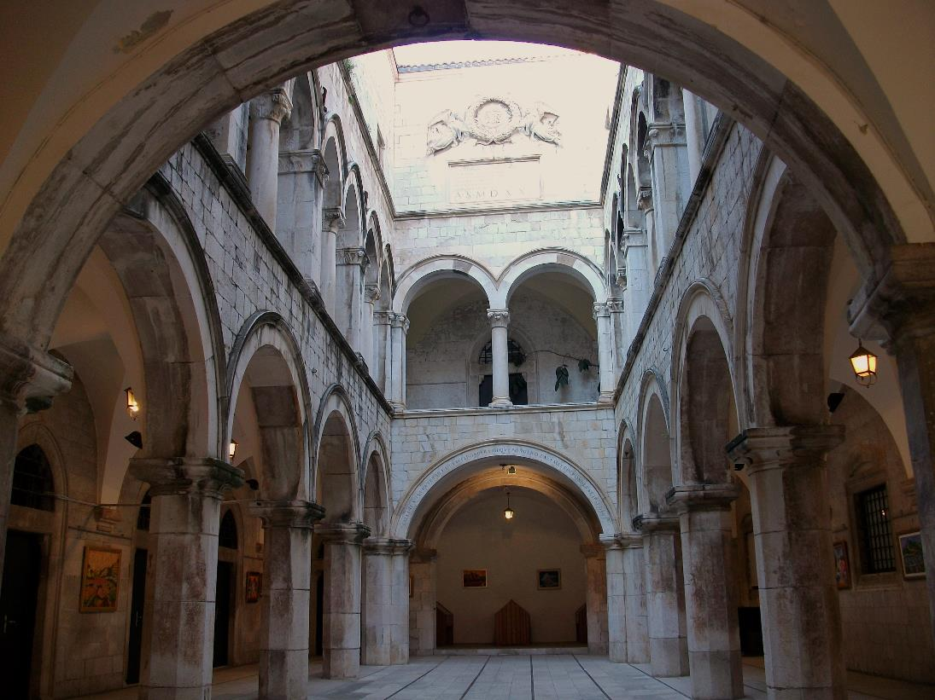
New: Volume Tiled Resources
Modeling the Sponza Atrium (2cm resolution)
Texture3D
Tiled Texture3D
1200 x 600 x 600 x 32bpp
=
1.6 GB
32 x 32 x 16 x 32bpp / volume tile
x
~2500 non-empty volume tiles
=
156 MB
Image credit: Wikimedia user Joanbanjo

Slide 23
Conservative Rasterization – Standard Rasterization is not enough
Rasterization tests point locations
Pixel centers
Multi-sample locations
Not everything drawn hits a sample
Some algorithms use low resolution
Even fewer sample points
Many triangles missed
We need a guarantee… we can’t miss anything
Conservative rasterization tests the whole pixel → the area

Slide 24
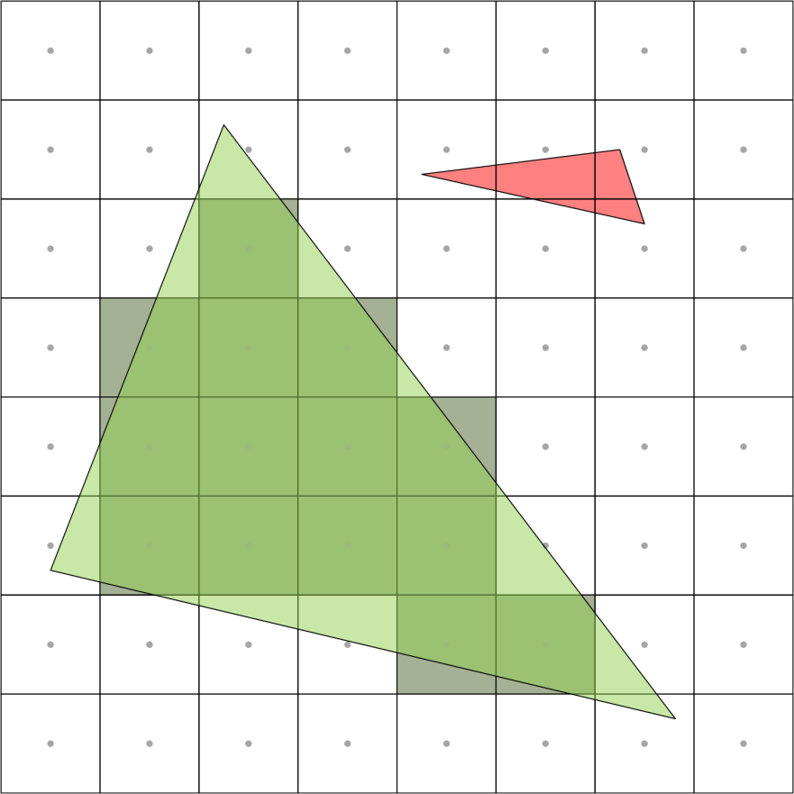
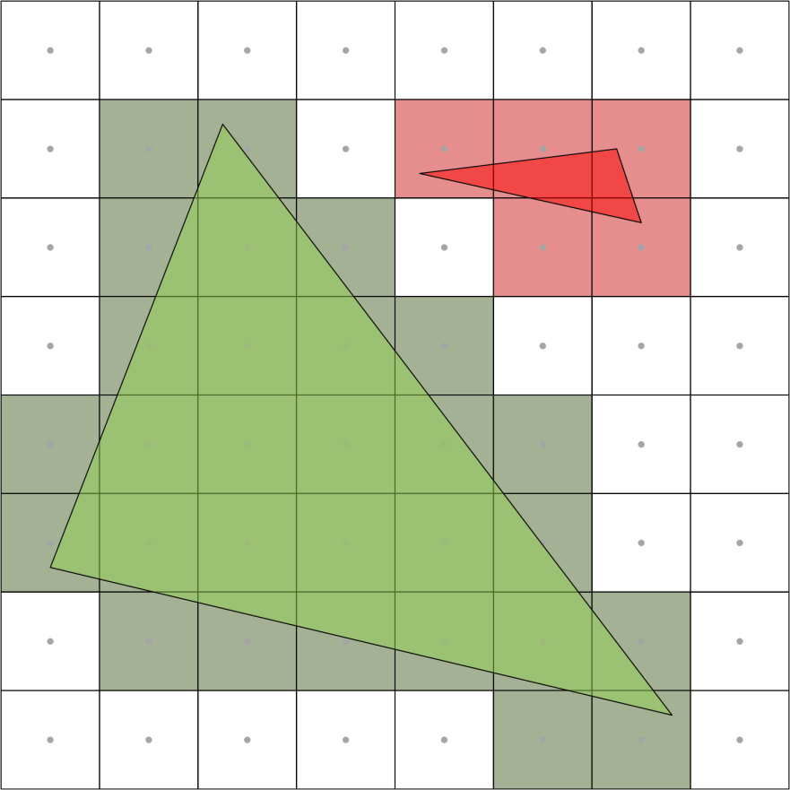
Conservative Rasterization
Standard Rasterization
Conservative Rasterization

Slide 25
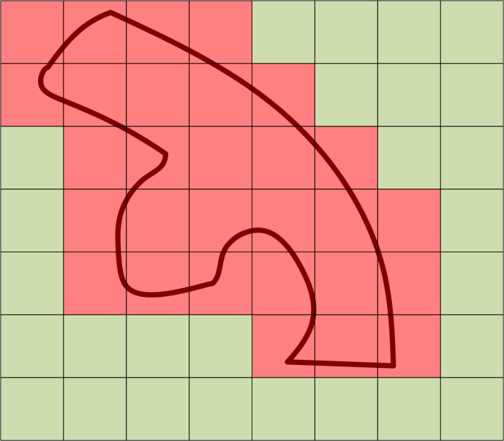
Conservative Rasterization
Construction of spatial data structures…
Where is everything? Is anything in this box? What?
Voxelization
Does the triangle touch the voxel?
Tile allocation
Rasterization at tile resolution
Is the tile touched? Does it need memory?
Collision detection
What things are in this part of space? What might I run into?
Occlusion culling
Classification of space – Can I see through here, or not?

Slide 26
The End

